Slide 1
Crime Trends in Austin: Seasonal Insights from 2003 to 2023
By: Julie, Prashant and Sarah

Slide 2
Resources
CSV Source: https://data.austintexas.gov/Public-Safety/Crime-Reports/fdj4-gpfu/about_data

Slide 3
Shoplifting by Season

Slide 4
Test 2: Shoplifting per Season
N0: If seasons are not related to shoplifting incidences, then the Winter months will not see an increase in identity theft.
N1: If seasons are related to shoplifting incidences, then the Winter months will show an increase in identity theft
Results:
Chi-squared test: 0.0
P-value: 1.0
Accept null hypothesis: Seasons are not related to shoplifting incidences

Slide 5
Bicycle Thefts Across Seasons

Slide 6
Test 3: Bicycle Theft across Seasons
N0: If seasons are not related to identity theft, then particular seasons will not see an increase in identity theft.
N1: If seasons are related to identity theft, then particular seasons will show an increase in identity theft.
Results:
Chi-squared test:
P-value:
Reject null hypothesis: Seasons do influence bicycle theft

Slide 7
Residential Burglaries Across Seasons

Slide 8
Test 5: Residential Burglaries across Seasons
N0: If seasons are not related to residential burglaries, then particular seasons will not see an increase in identity theft.
N1: If seasons are related to residential burglaries, then particular seasons will show an increase in identity theft.
Results:
Chi-squared test:
P-value:
Reject null hypothesis: Seasons do influence residential burglaries
Notes:
##reject null
#Bc the chi-square stat is so high, and the p-value is less than .05, this indicates that there is significant data
#indicating that season is a factor in identity theft crimes, and peaks in the Winter

Slide 9
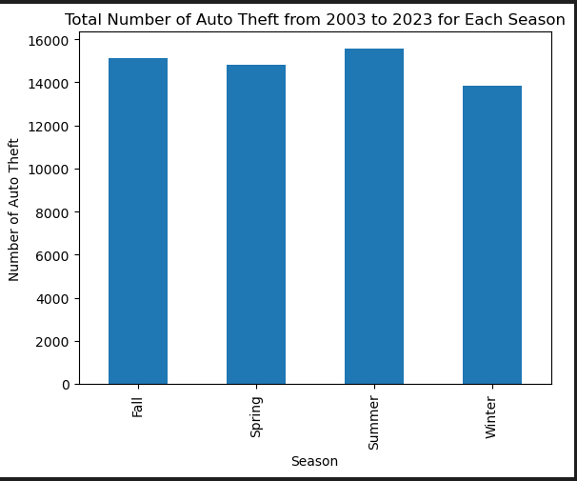
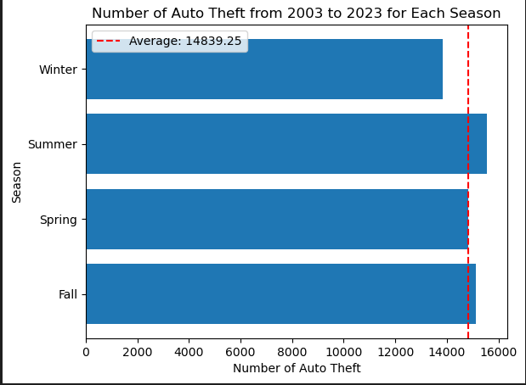
Overall and Averages Data of Auto Theft

Slide 10
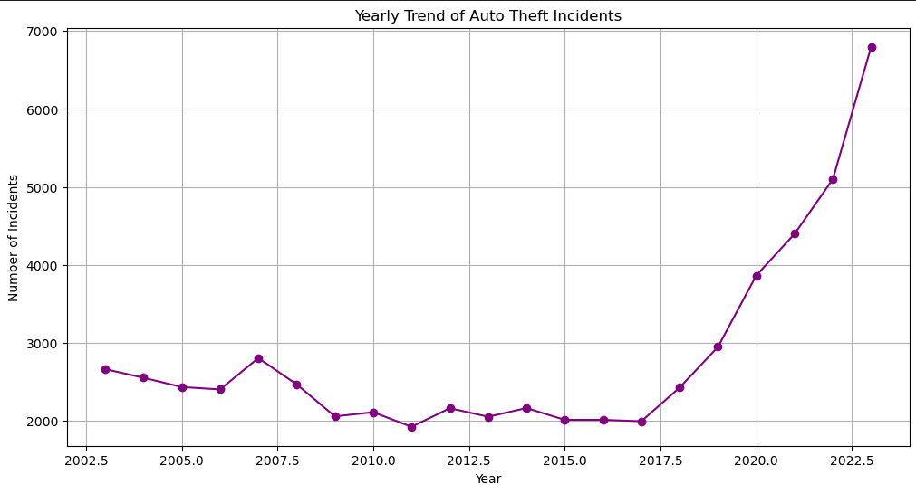
Overall Trend Over 20 Years

Slide 11
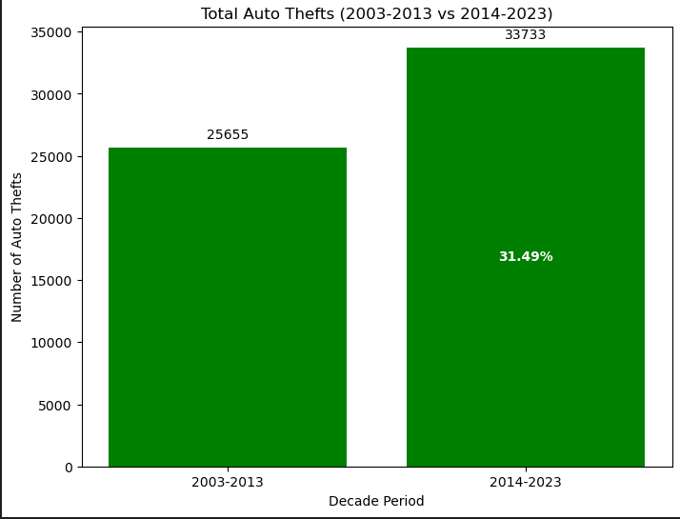
Increase in Number of Occurrences Compared to Previous Decade

Slide 12
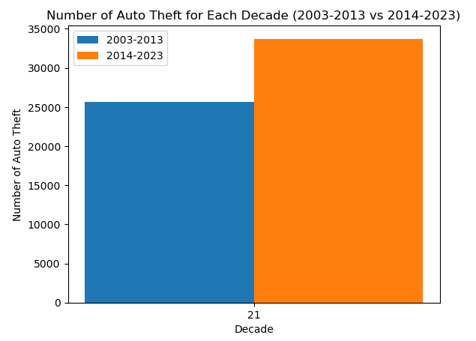
Auto Theft Over the Decades
33733
25655
31.49%

Slide 13
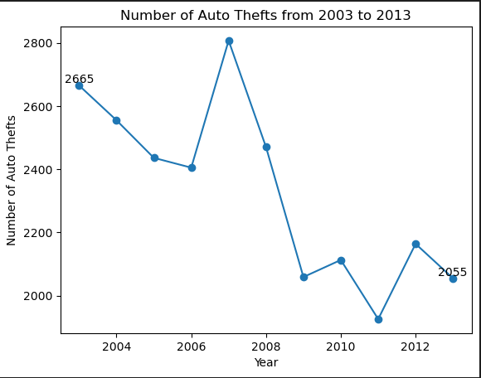
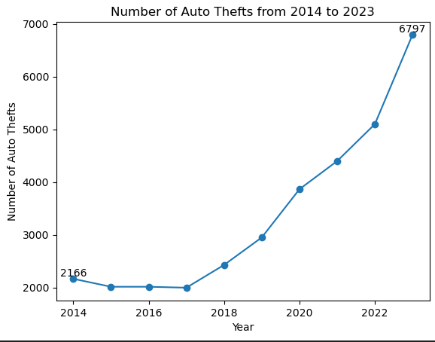
Comparison of Occurrences Between Two Ten Year Periods
Auto Thefts Between 2003-2013 -22.89% of 25,655 Total Occurrences
Auto Thefts Between 2014-2023 +213.80% of 33,733 Total Occurrences

Slide 14
Test 4: Auto Theft across Seasons
N0: If seasons are not related to Auto theft, then particular seasons will not see an increase in identity theft.
N1: If seasons are related to auto theft, then particular seasons will show an increase in identity theft.
Results:
Chi-squared test:
P-value:
Reject null hypothesis: Seasons do influence auto theft

Slide 15
Identity Theft Over the Years

Slide 16
Identity Theft per Season

Slide 17
Test 1: Identity Theft per Season
N0: If seasons are not related to identity theft, then the Winter months will not see an increase in identity theft.
N1: If seasons are related to identity theft, then the Winter months will show an increase in identity theft
Results:
Chi-squared test:
P-value:
Reject null hypothesis: Seasons are related to identity theft.

Slide 18
Overall Conclusion
Seasons do influence crime in residential burglaries, auto thefts, bicycle thefts, and identity theft.
Seasons do NOT impact shoplifting incidences

